Slide 1
LVDS to NIM module from Bari for Original RPCs in CMS
Isabel & Ian
11 Sept 2023

Slide 2
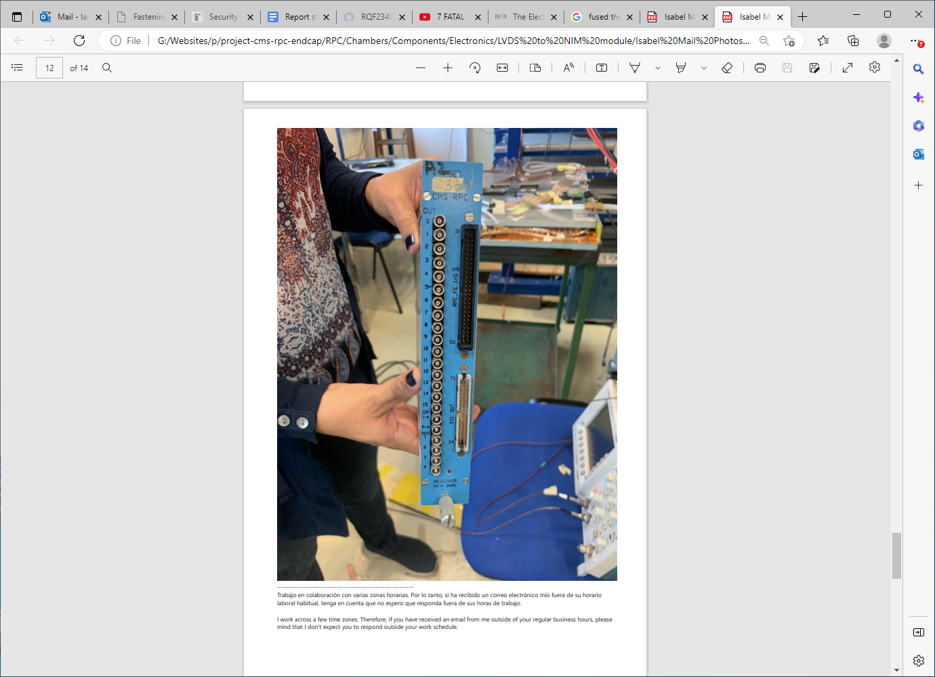
Photos from Isabel

Slide 3
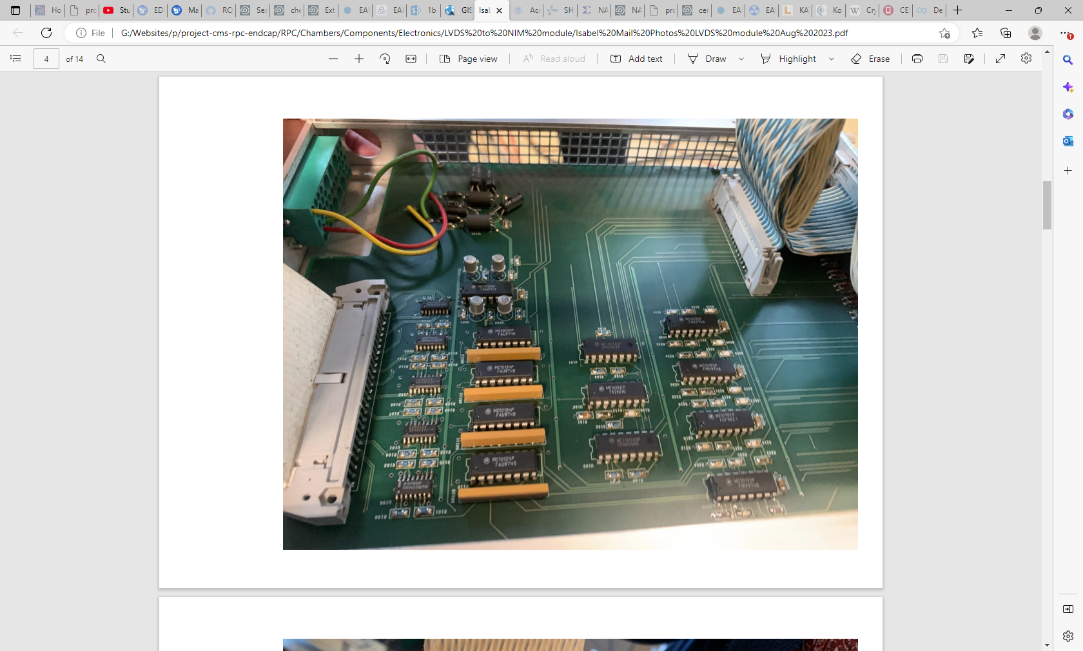

Slide 4
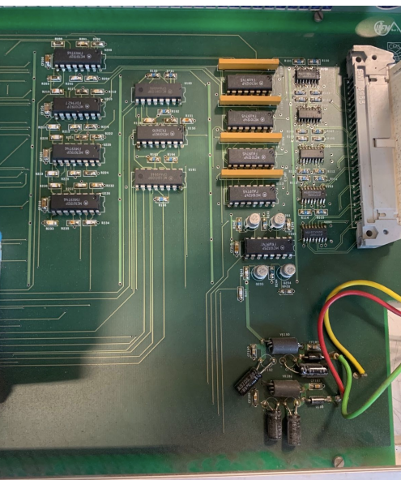
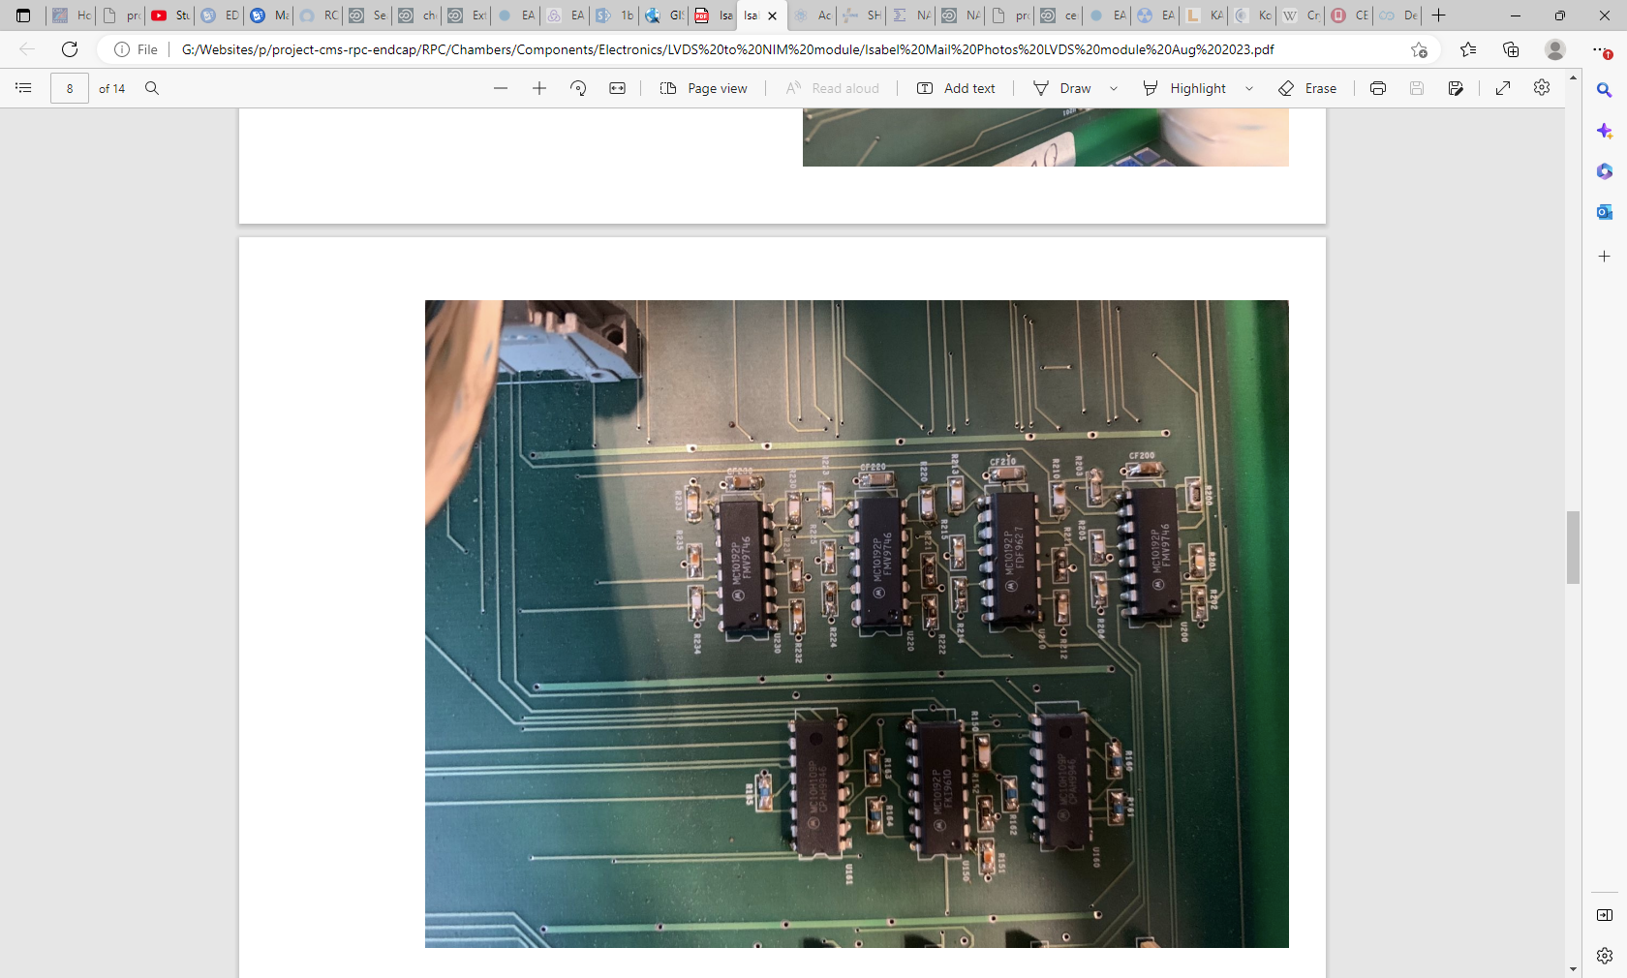

Slide 5
MC10192P
FMV9746 this number changes between same type ASICs

Slide 6
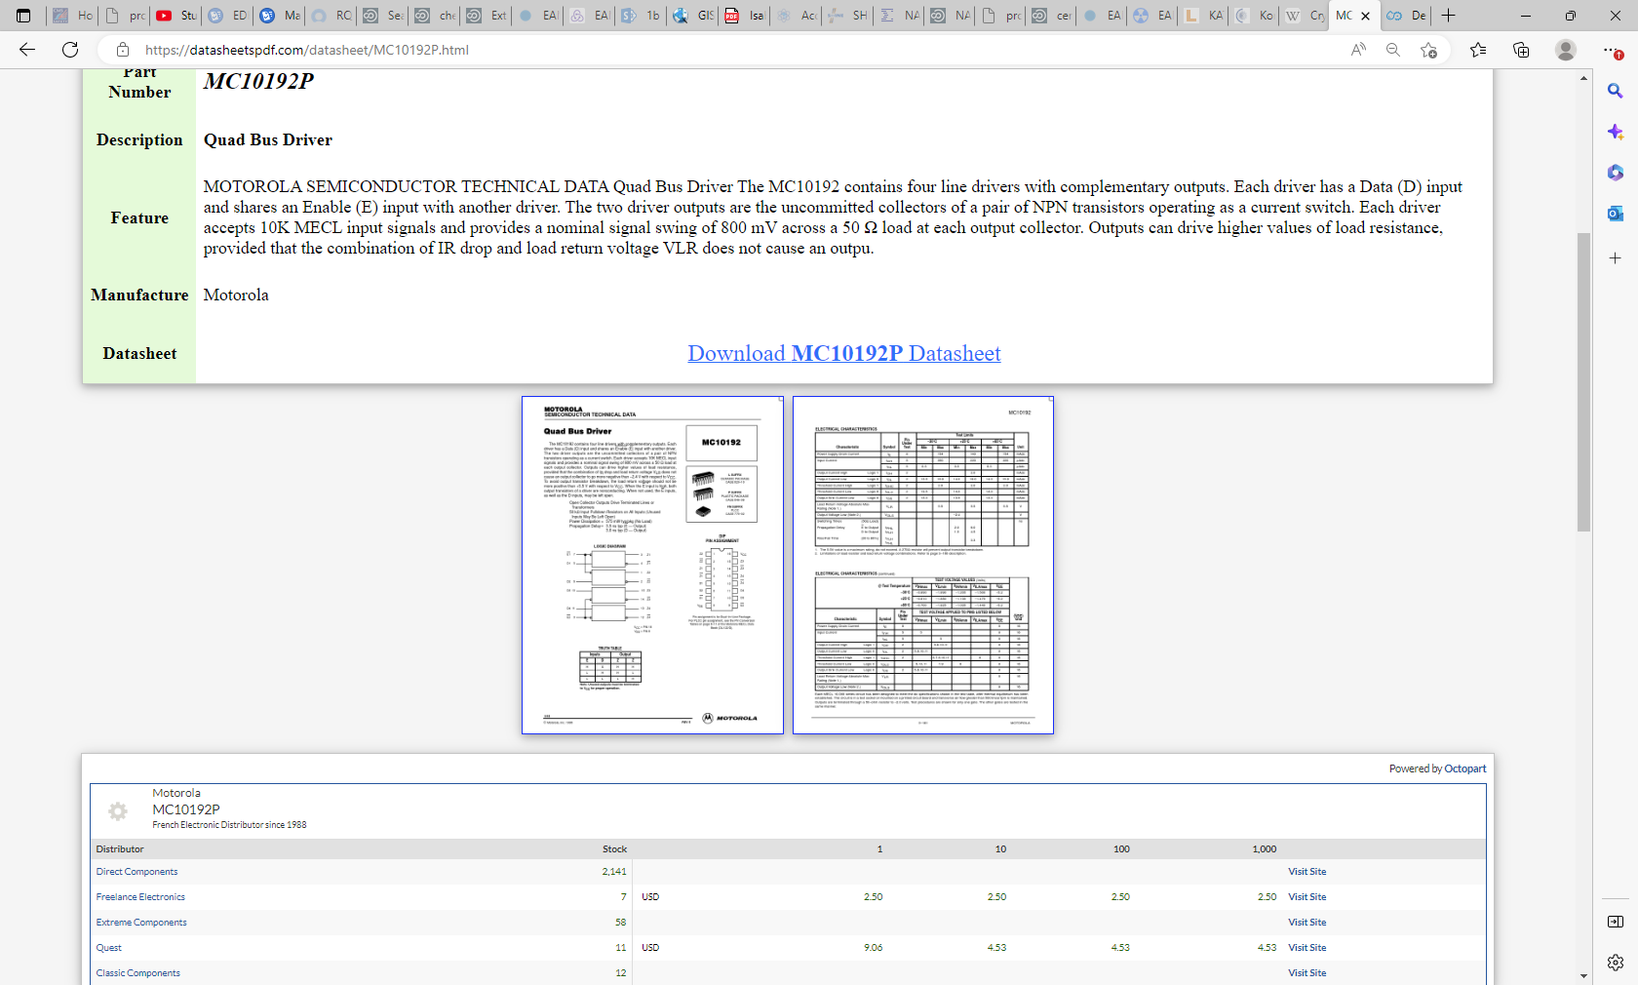

Slide 7
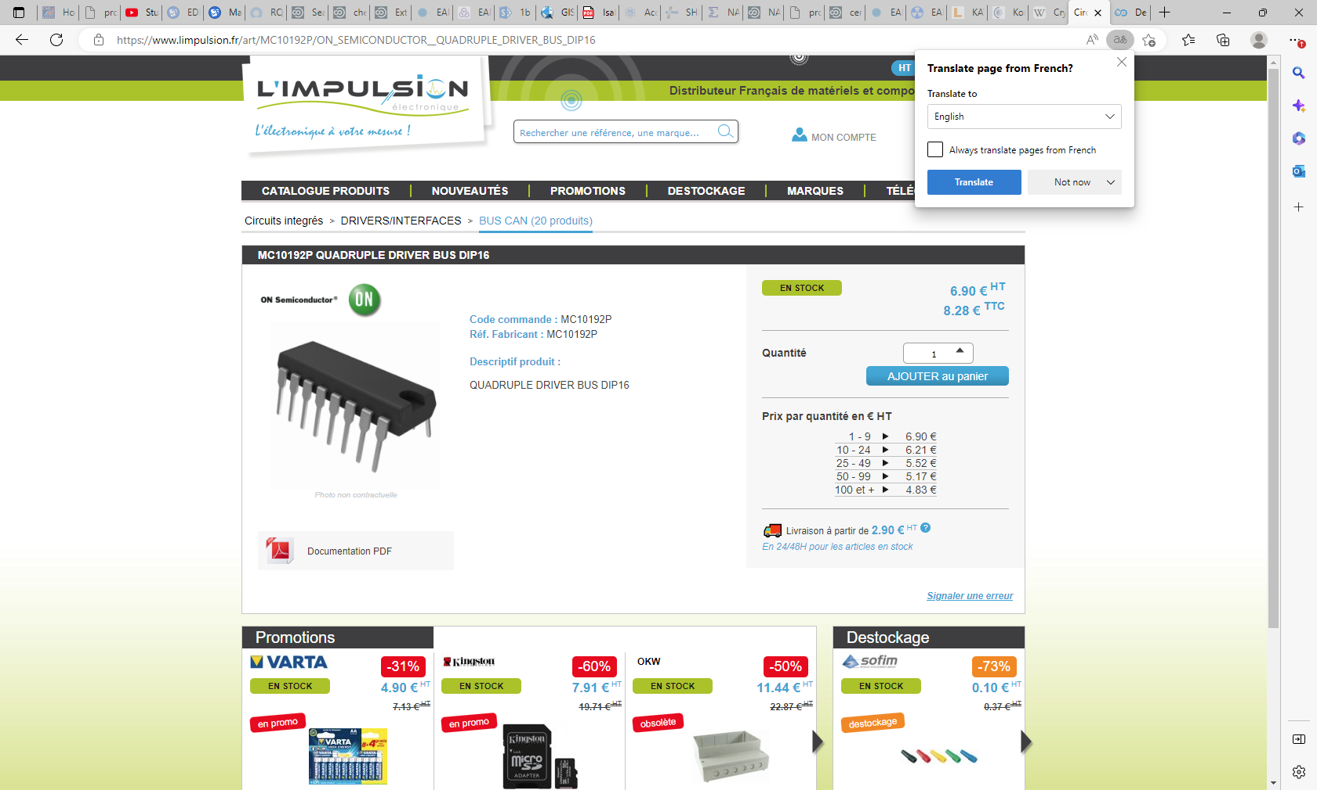

Slide 8
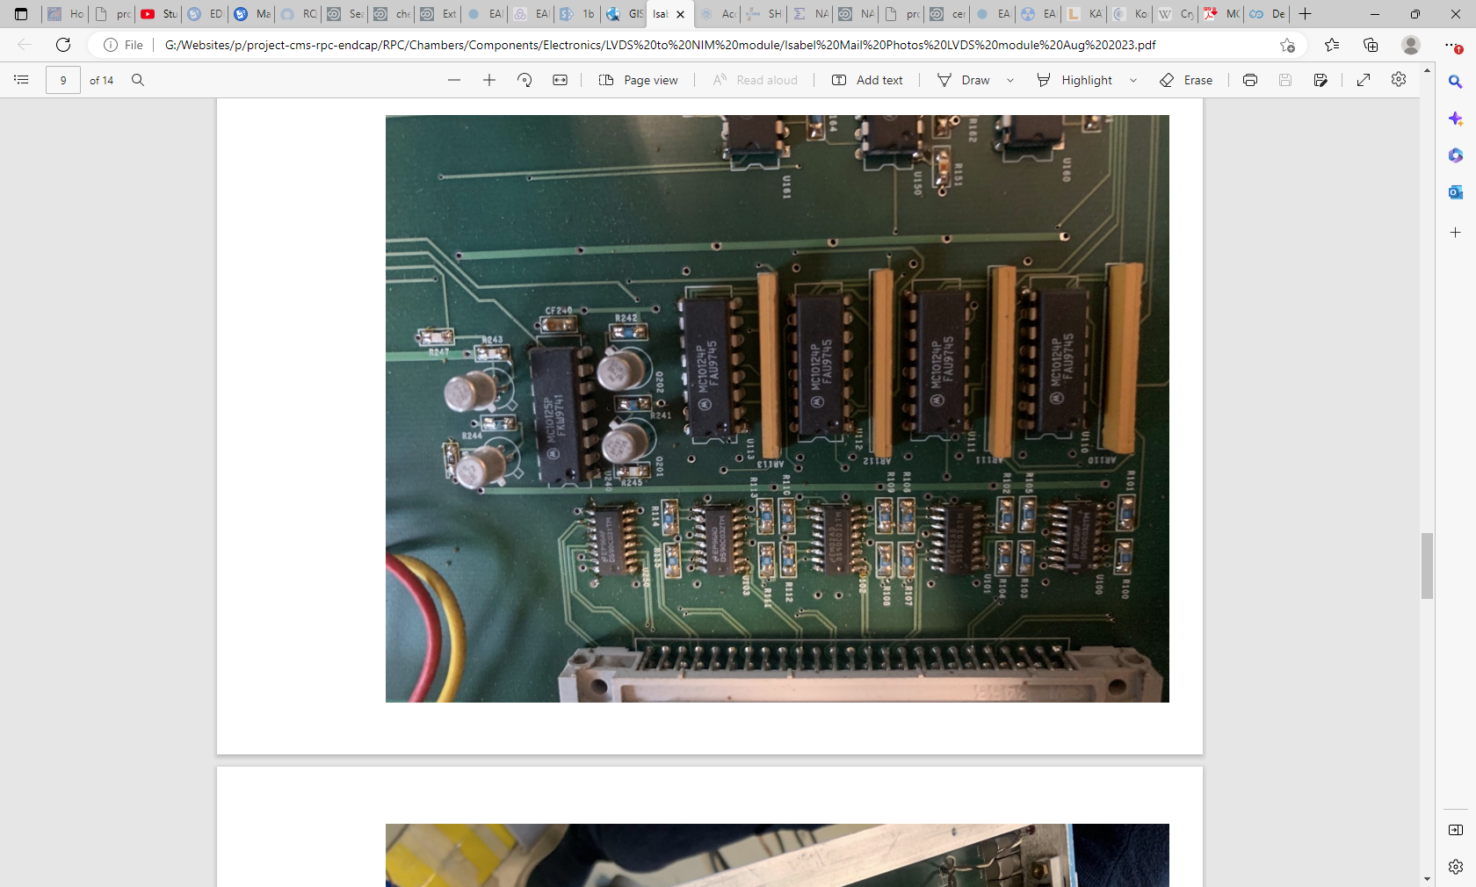

Slide 9
MC10124P
FAU9745
MC10125P
FKW9741

Slide 10
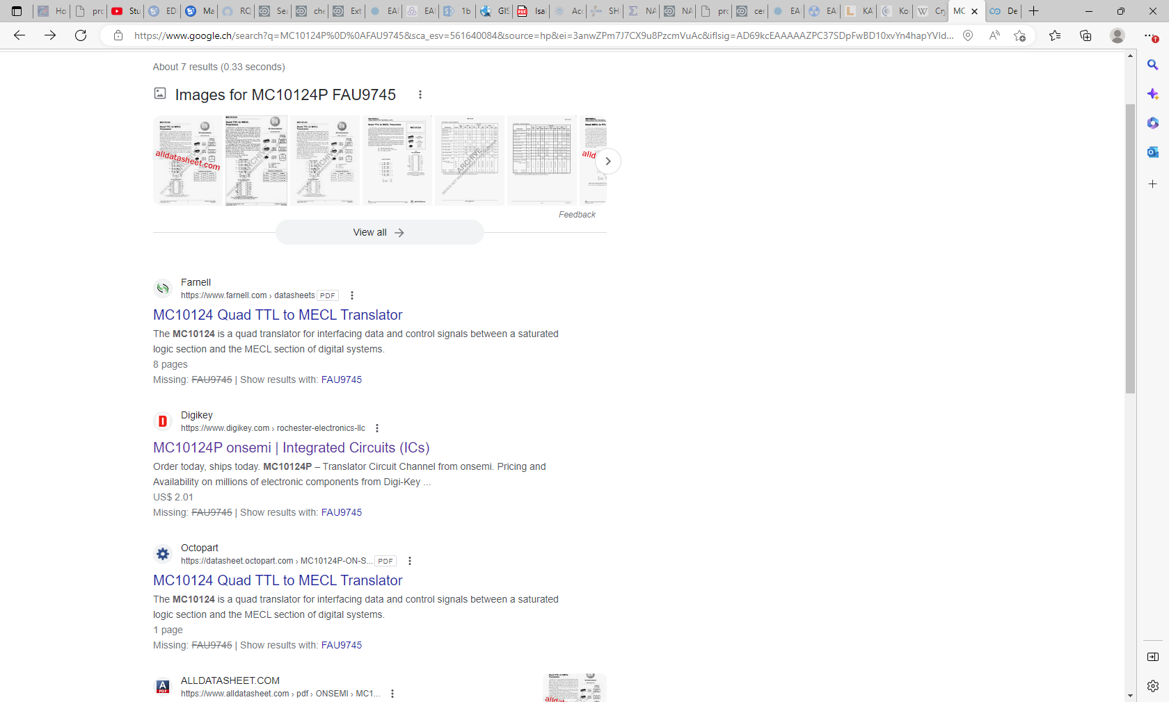

Slide 11
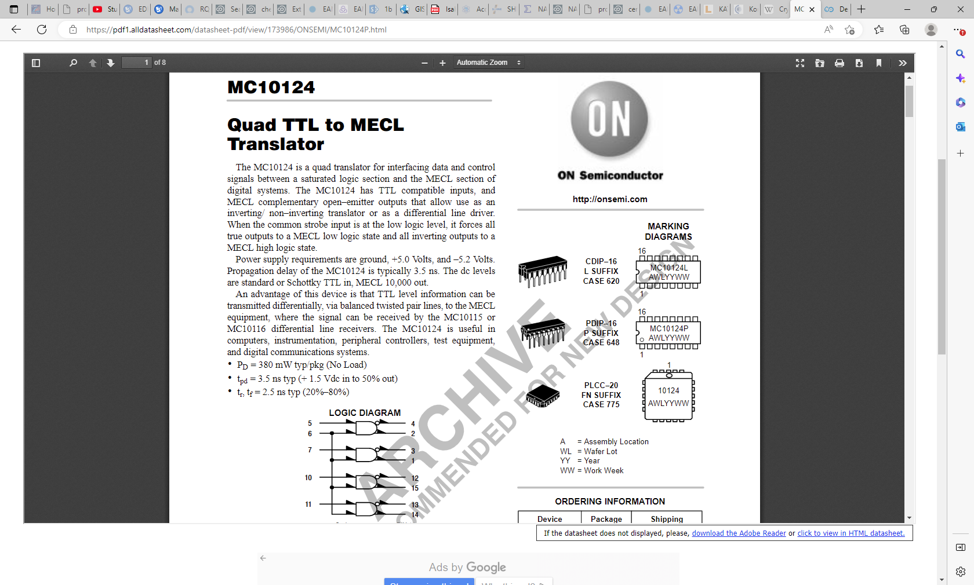
https://pdf1.alldatasheet.com/datasheet-pdf/view/173986/ONSEMI/MC10124P.html

Slide 12
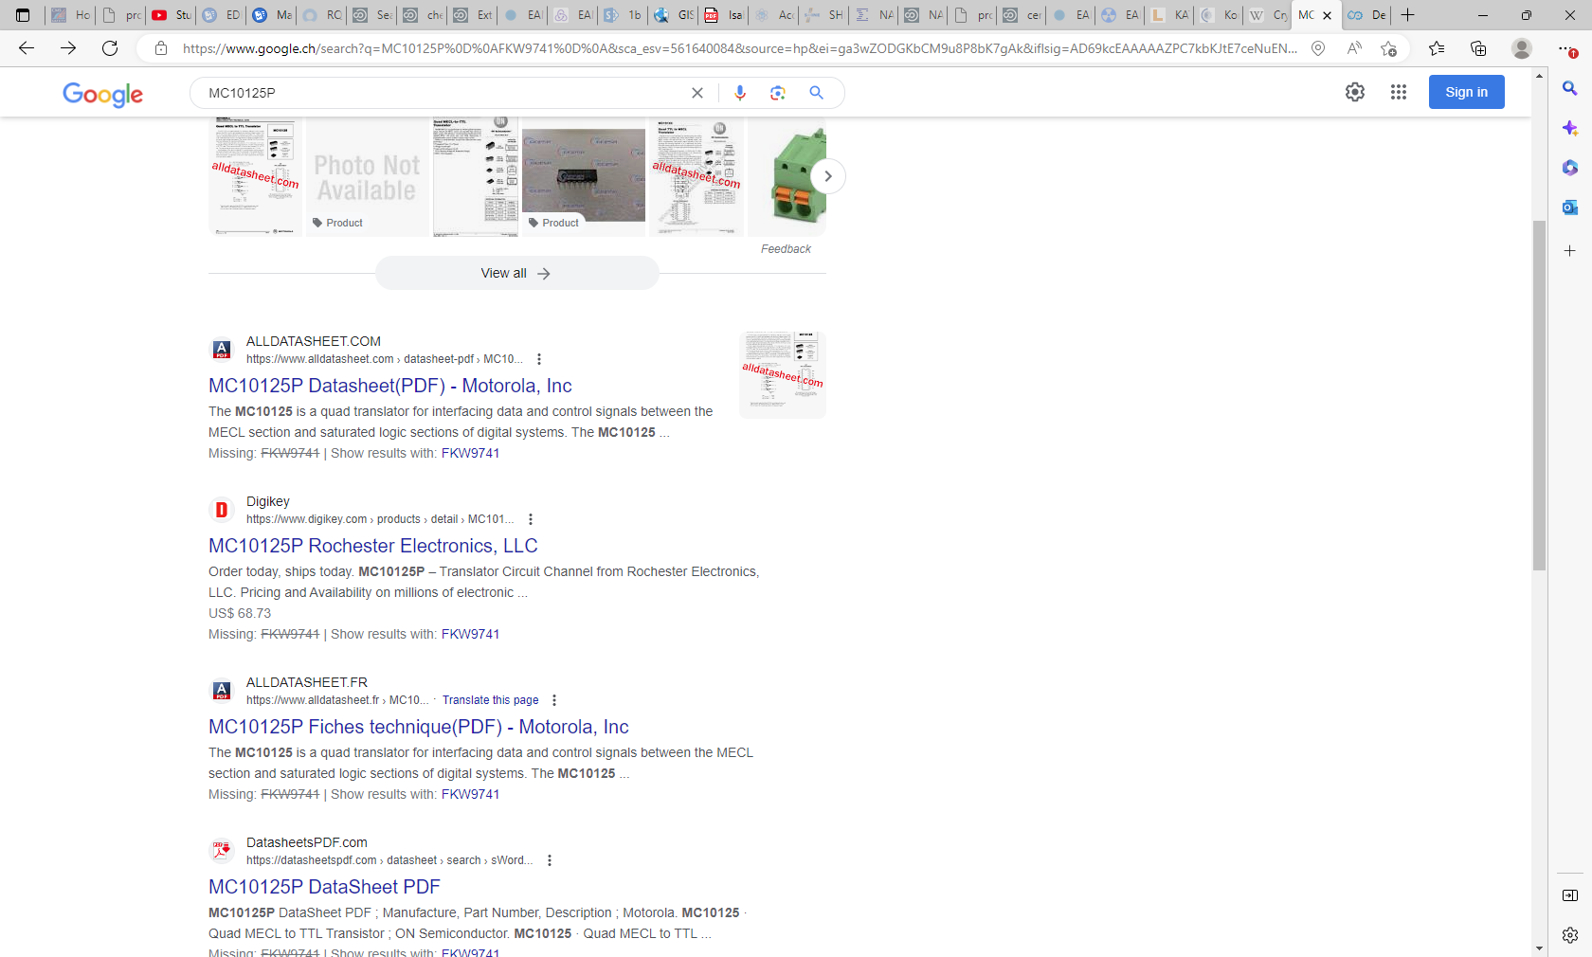
MC10125P
FKW9741
I am not able to access Digikey.com !!

Slide 13
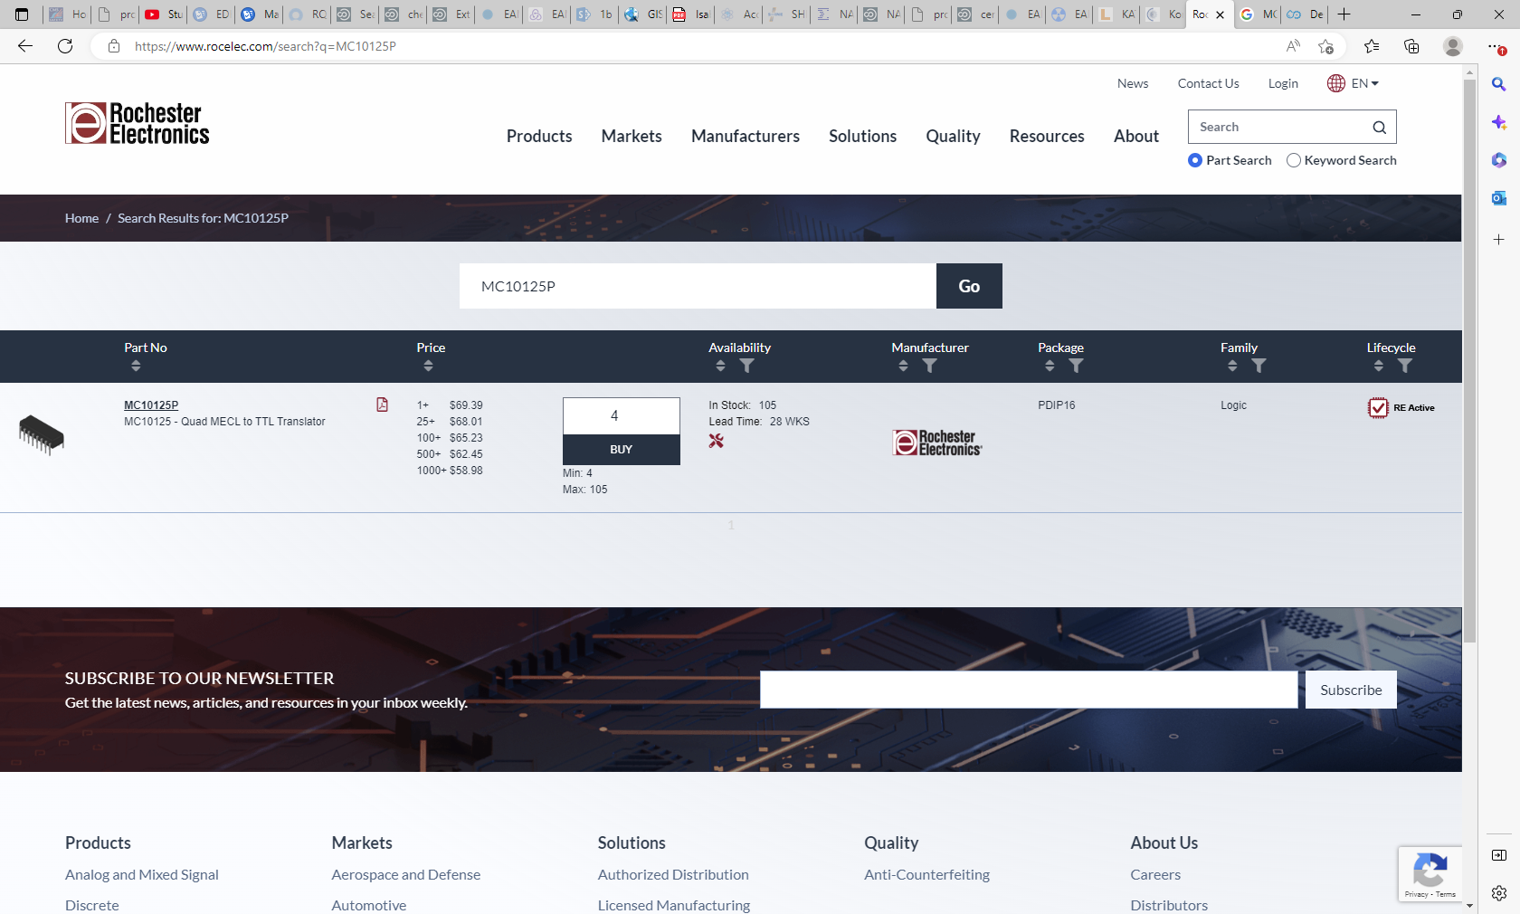
https://www.rocelec.com/search?q=MC10125P

Slide 14
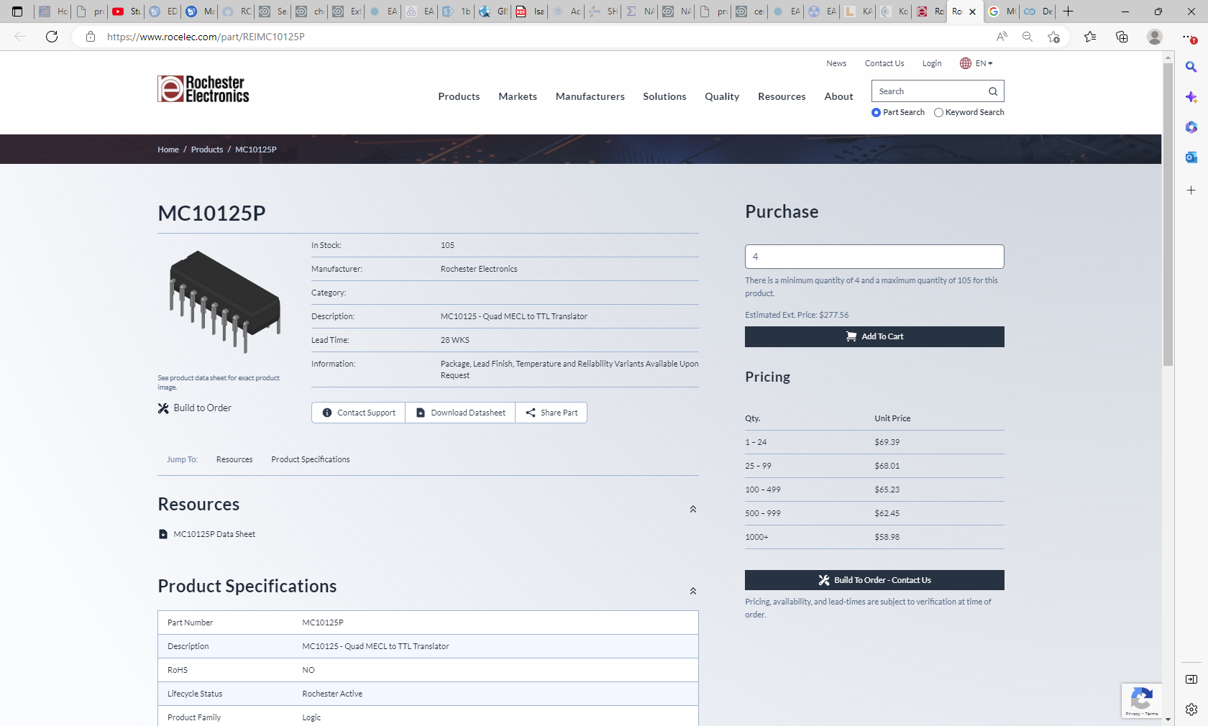

Slide 15
EP96AD
DS90C032TM
EM02AD
DS90C032TM
EM (?)02AD
DS90C032TM

Slide 16
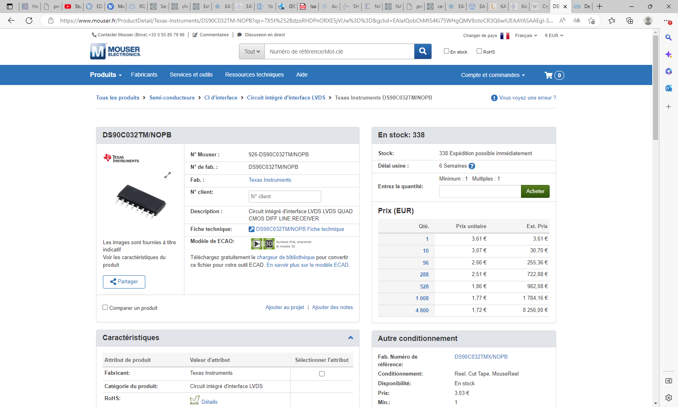

Slide 18
